Slide 1

Abhishek Thakur

Slide 2

Spring Data – One API To Rule Them All
What is Spring Data ?
- Spring data is a Data Access Abstraction .
- With Spring Data, you may use Hibernate, Eclipse Link
or any other JPA provider.
- It can generate JPA queries on your behalf
through method name conventions.
Notes:
It makes it easy to use data access technologies, relational and non-relational databases, map-reduce frameworks, and cloud-based data services.

Slide 3
Main Modules
Spring Data Commons - Core Spring concepts underpinning every Spring Data project.
Spring Data Gemfire - Provides easy configuration and access to GemFire from Spring applications.
Spring Data JPA - Makes it easy to implement JPA-based repositories.
Spring Data JDBC - JDBC-based repositories.
Spring Data KeyValue - Map-based repositories and SPIs to easily build a Spring Data module for key-value stores.
Spring Data LDAP - Provides Spring Data repository support for Spring LDAP.
Spring Data MongoDB - Spring based, object-document support and repositories for MongoDB.
Spring Data REST - Exports Spring Data repositories as hypermedia-driven RESTful resources.
Spring Data Redis - Provides easy configuration and access to Redis from Spring applications.
Spring Data for Apache Cassandra - Spring Data module for Apache Cassandra.
Spring Data for Apache Solr - Spring Data module for Apache Solr.

Slide 4
Community modules
Spring Data Aerospike - Spring Data module for Aerospike.
Spring Data ArangoDB - Spring Data module for ArangoDB.
Spring Data Couchbase - Spring Data module for Couchbase.
Spring Data Azure DocumentDB - Spring Data module for Microsoft Azure DocumentDB.
Spring Data DynamoDB - Spring Data module for DynamoDB.
Spring Data Elasticsearch - Spring Data module for Elasticsearch.
Spring Data Hazelcast - Provides Spring Data repository support for Hazelcast.
Spring Data Jest - Spring Data for Elasticsearch based on the Jest REST client.
Spring Data Neo4j - Spring based, object-graph support and repositories for Neo4j.
Spring Data Vault - Vault repositories built on top of Spring Data KeyValue.

Slide 5
Related modules
Spring Data JDBC Extensions - Provides extensions to the JDBC support provided in the Spring Framework.
Spring for Apache Hadoop - Simplifies Apache Hadoop by providing a unified configuration model and easy to use APIs for using HDFS, MapReduce, Pig, and Hive.
Spring Content - Associate content with your Spring Data Entities and store it in a number of different stores including the File-system, S3, Database or Mongo’s GridFS.

Slide 6
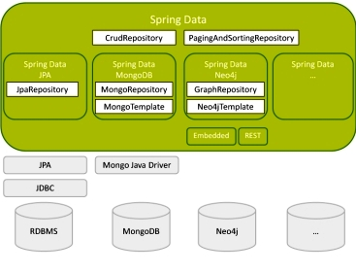
Strucuture

Slide 7
HOW TO ?
SETUP
CRUD
CUSTOM METHOD QUERIES
Property expressions
@QUERY
N more

Slide 8
Advantages
No more Dao layer
Less code less unit testing
Manual + Automatic queries
No worry for Db change
No worry for JPA provided change

